Slide 1

Network Visualization of the characters in Dream of the Red Chamber (《红楼梦》).
Final project for Chin 370
by Ryno Chen

Slide 2
& ME
Dream of the Red Chamber
My “Good Old Time”

Slide 3
Goals
Web-scraping (80 Chapters)
Form Generation (Nodes & Edges)
Graph Drawing:
Relationship
Significance

Slide 4
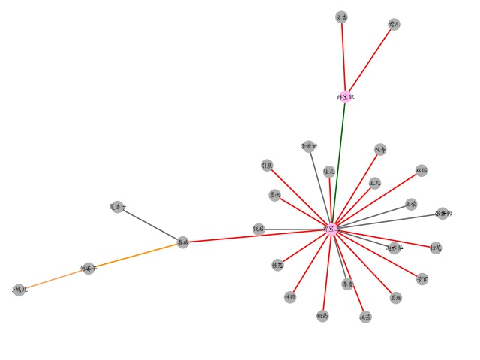
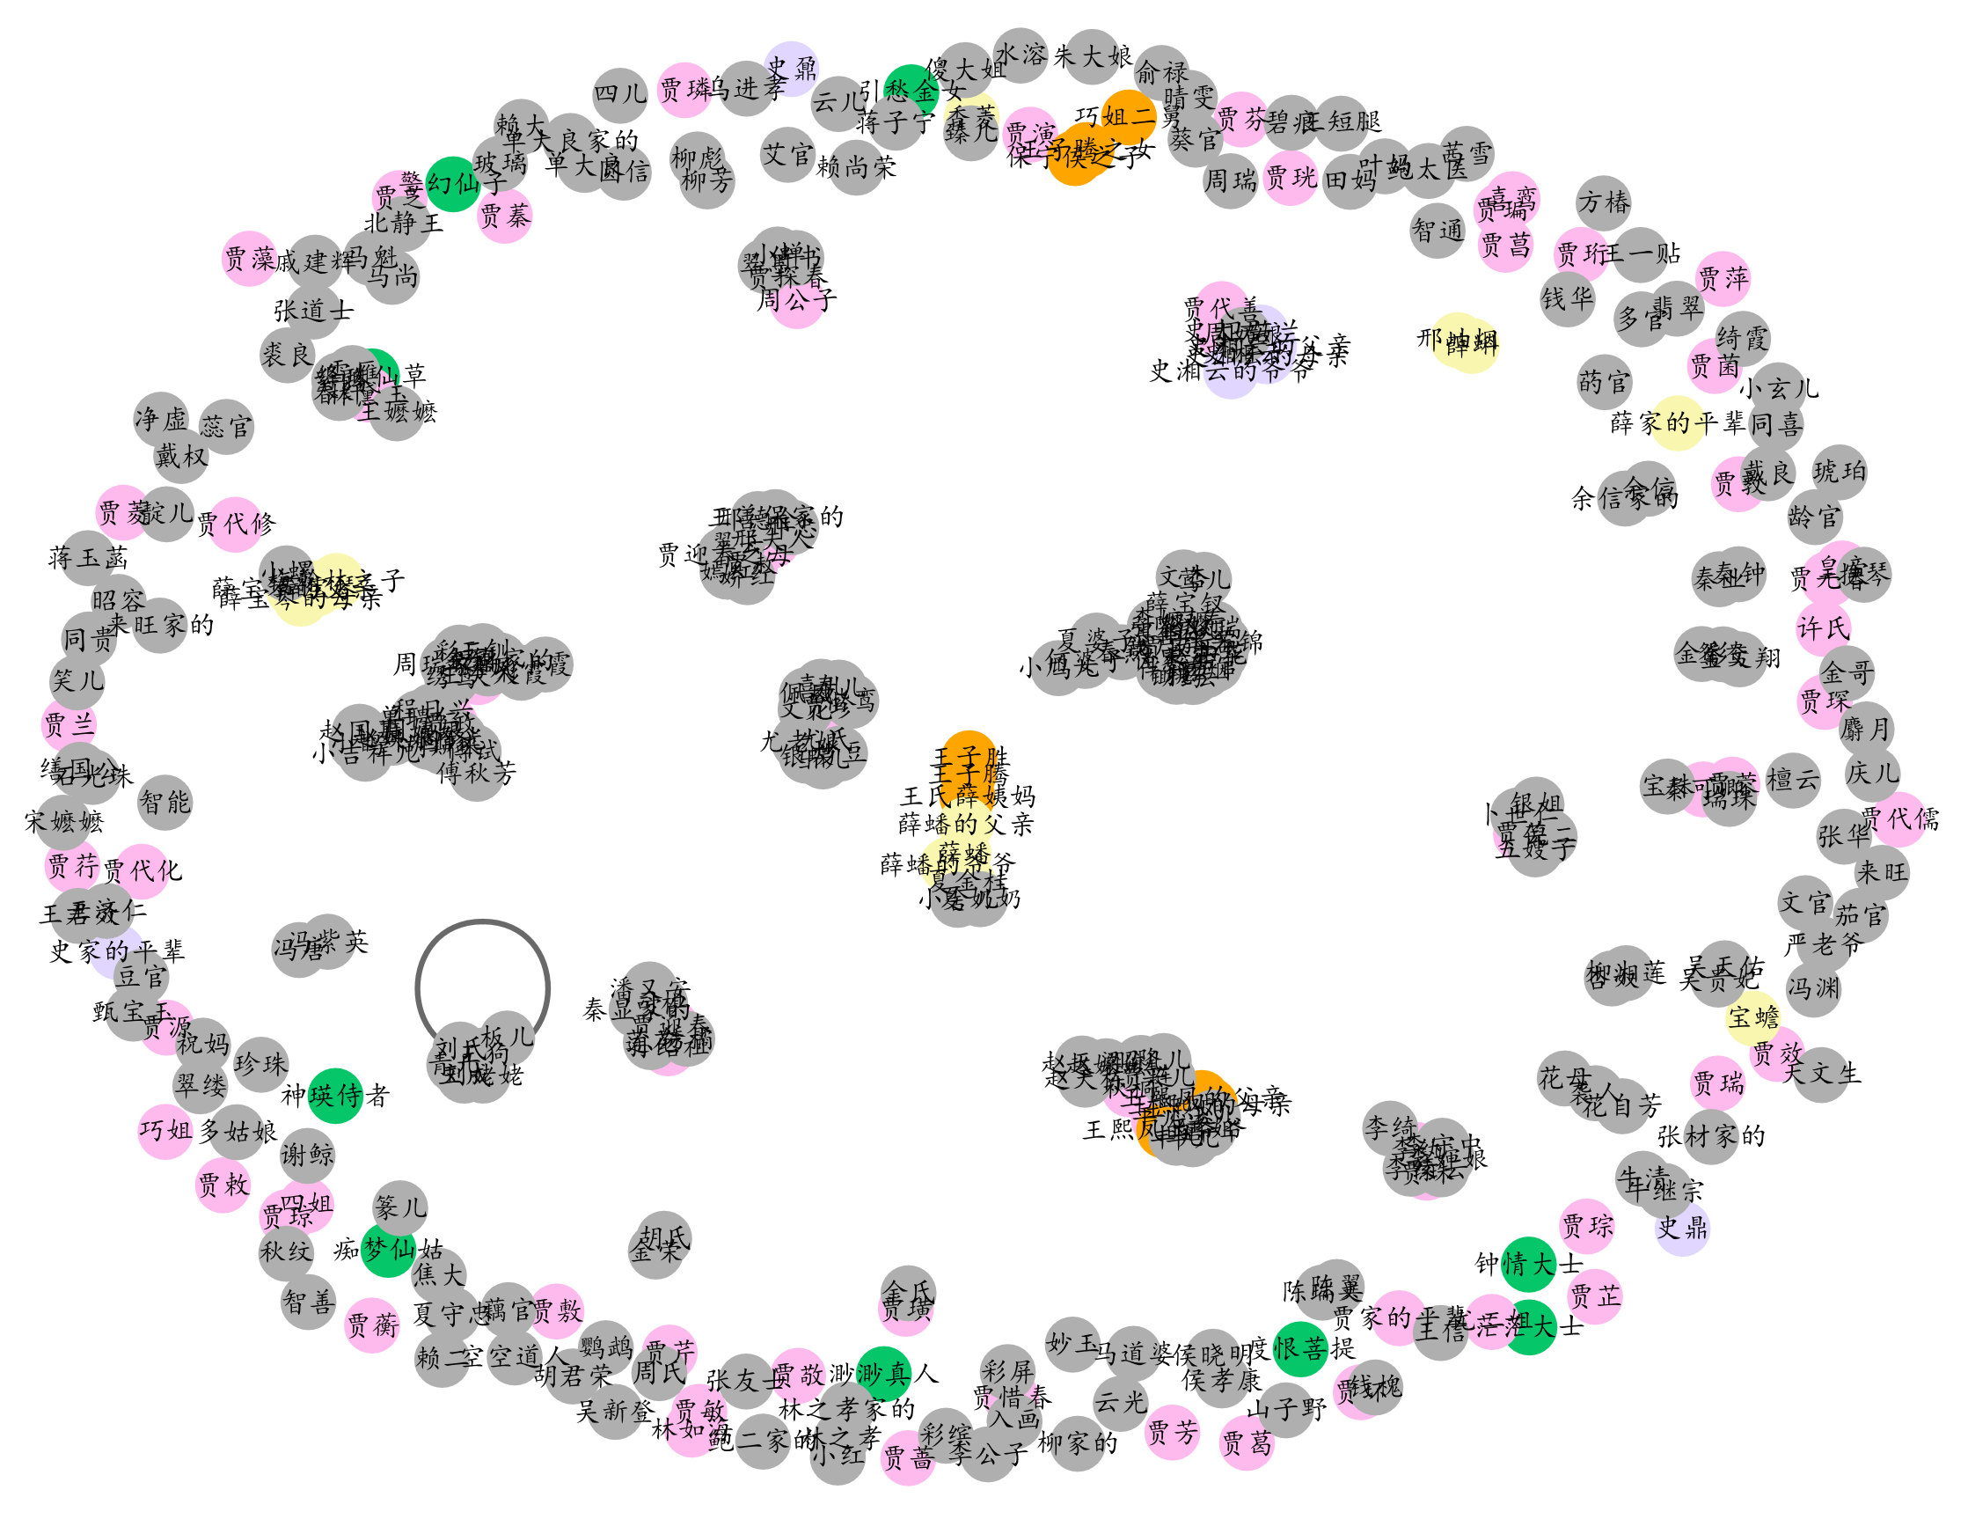
Yet Unsolved Problem:
May need to figure out how to generate the legend
Results Presentation
Relationships among Characters

Slide 5
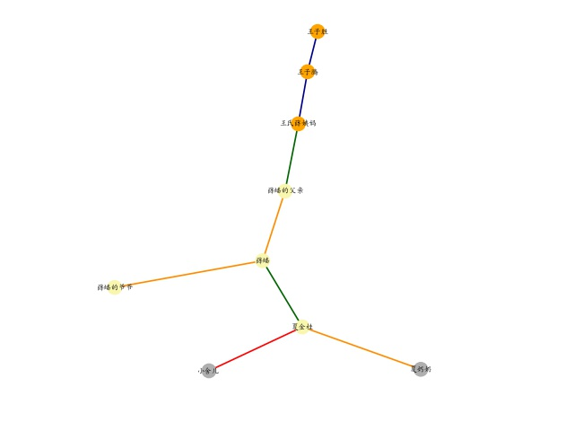
Results Presentation
NOTE:
not exhaustive
Relationships among Characters

Slide 6
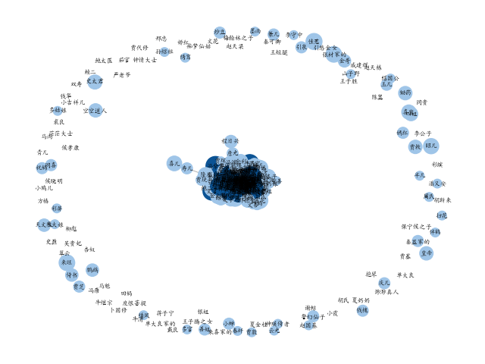
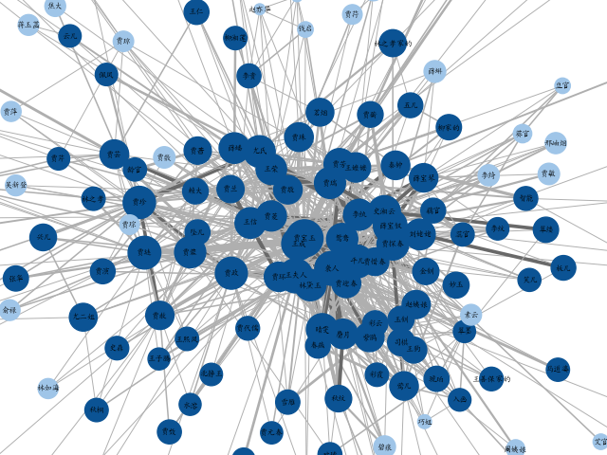
Character Importance & character correlation
Color
Weight

Slide 7
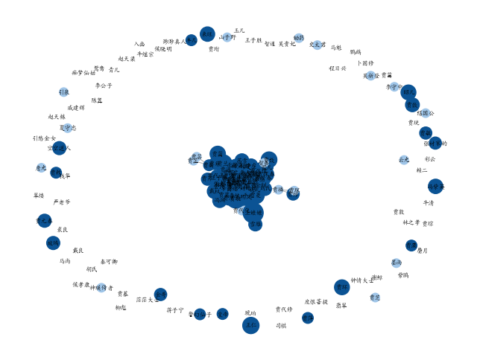
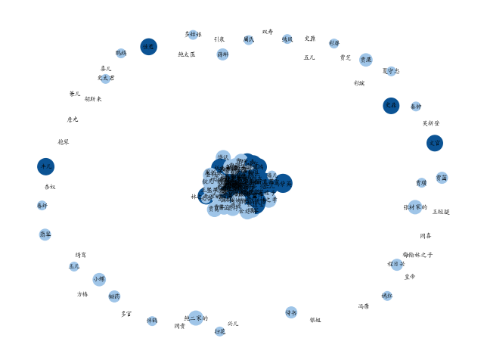
Character Importance & character correlation
Ch 1 - 17
Ch 18 - 53

Slide 8
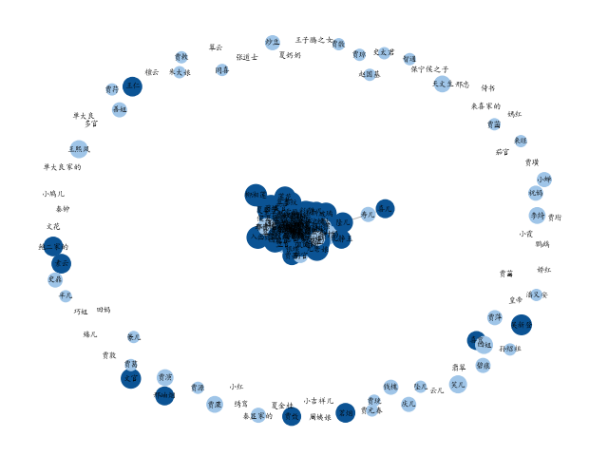
Character Importance & character correlation
Ch 54 - 80
ALL 1 - 80

Slide 9
References: character information: 笔记：小说《红楼梦》所有人物整理 - 知乎 (zhihu.com) Original text: (红楼梦全文_古诗文网 (gushiwen.cn)
Thanks
for
Listening

